Slide 1
Making the Connection:
Evidence Collection in
Elder Abuse Cases
Tana Mooney, Domestic Violence Coordinator, Chesterfield Police Department
Mike Huberman, Chief Deputy, Henrico County Commonwealth’s Attorney’s Office
Notes:
Mike

Slide 2

Presentation overview
Interviewing, Evidence Collection, and Documentation
  Physical Abuse
  Sexual abuse
  Neglect
  Financial exploitation
MH
Notes:
Mike

Slide 3
Abuse/Neglect of VULNERABLE Adults - §18.2-369
(amendments Effective 7/1/22)
Financial exploitation of
VULNERABLE ADULTS - §18.2-178.1
(amendments Effective 7/1/22)
FINANCIAL EXPLOITATION BY AN AGENT - §18.2-178.2
(Effective 7/1/22)
Elder abuse
Specific Code sections
Notes:
Mike

Slide 4
Abuse/Neglect of VULNERABLE Adults - §18.2-369
(Effective July 1, 2022)
Vulnerable Adult is defined as:
  Any person 18 years of age or older
  Who is impaired by reason of mental illness, intellectual or developmental disability, physical illness or disability, advanced age or other causes
    To the extent the adult lacks sufficient understanding or capacity to make, communicate or carry out reasonable decisions concerning his or her well-being, or
    Has one or more limitations that substantially impair the adult’s ability to independently provide for his daily needs or safeguard his person, property, or legal interests.
Responsible person is defined as:
  A person who has responsibility for the care, custody or control of a vulnerable adult by operation of law,
    OR
  Who has assumed such responsibility voluntarily, by contract or in fact.
  MH
Notes:
Mike

Slide 5
Abuse/Neglect of Incapacitated Adults - §18.2-369
(Effective July 1, 2022)
A. It shall be unlawful for any responsible person to abuse or neglect any vulnerable adult.
Abuse is defined as:
Causes physical injury or pain
  OR
Knowing and willful use of physical restraint, including confinement, as punishment, for convenience or as substitute for treatment
Neglect is defined as:
Failure to provide treatment, care, goods or services
Results in injury or endangers safety
Notes:
Mike

Slide 6
Financial exploitation of vulnerable adults - §18.2-178.1
(Effective July 1, 2022)
A. It is unlawful for any person who knows or should know that another person is a vulnerable adult to, through the use of that other person’s impairment, take, obtain, or convert money or other thing of value belonging to that other person with the intent to permanently deprive him thereof. Any person who violates this section shall be deemed guilty of larceny.
.
Notes:
Mike

Slide 7
Financial exploitation by an agent- §18.2-178.2
(Effective July 1, 2022)
B. An agent under a power of attorney who knowingly or intentionally engages in financial exploitation of an incapacitated adult who is the principal of that agent is guilty of a Class 1 misdemeanor. A violation of this section shall constitute a separate and distinct offense. If the acts or activities violating this section also violate another provision of law, a prosecution under this section shall not prohibit or bar any prosecution or proceeding under such other provision or the imposition of any penalties provided for thereby.
Notes:
Mike

Slide 8
Financial exploitation by an agent- §18.2-178.2
(Effective July 1, 2022)
B. An agent under a power of attorney who knowingly or intentionally engages in financial exploitation of an incapacitated adult who is the principal of that agent is guilty of a Class 1 misdemeanor. A violation of this section shall constitute a separate and distinct offense. If the acts or activities violating this section also violate another provision of law, a prosecution under this section shall not prohibit or bar any prosecution or proceeding under such other provision or the imposition of any penalties provided for thereby.
Notes:
Mike

Slide 9
Factors that may impede effective criminal justice response to elder abuse
Ageism
Suspect is an adult child or grandchild
Disbelief that elders are sexually assaulted
Some reporting discounted is as psychotic or demented
Forensic indicators are often missed or misinterpreted on an older body
Response to allegations often insufficient
A lack of dedicated staff
Inadequate investigations by law enforcement
Lack of training in prosecuting cases where the victim is cognitively impaired, uncooperative, or deceased
Lack of victim advocates to explain the allegations and help transport elders to court
Limited funding for medical and forensic experts to evaluate victims and testify on their capacity
Apathy among judges, law enforcement, and attorneys toward elder abuse
Refusal of many prosecutors to accept cases they are not guaranteed to win TM
Notes:
Beth: NOT TO BE READ – the point is that there are many!
Resources:
Courtney O’Hara
2003 American Prosecutor Research Institute (APRI) survey Miller ML, Johnson JL. Protecting America’s seniors: What local prosecutors are doing to fight elder abuse. American Prosecutors Research Institute: Bureau of Justice Assistance, Office of Justice Programs, US Department of Justice; 2003
Prosecutors’ Perspectives on Elder Justice Using an Elder Abuse Forensic Center, Marguerite DeLiema,¹ Adria E. Navarro,² Melyssa Moss,³ and Kathleen H. Wilber⁴
Am J Crim Justice. Author manuscript; available in PMC 2018 Oct 14.
Published in final edited form as: Am J Crim Justice. 2016 Dec; 41(4): 780–795. Published online 2016 Jan 9. doi: 10.1007/s12103-015-9321-7

Slide 10
Evidence Based practice
Evidence-based prosecution (sometimes called "victimless prosecution") is the idea of building a domestic violence case and going forward as often as possible to convict offenders even if the victim does not want to cooperate
  Requires a foundation of ensuring the right person was arrested, the predominant physical aggressor
  Requires an evidence-based investigation
No drop policy
Victims for various reasons may be unavailable to testify
Even if victims testify, we should have additional evidence to support/corroborate their testimony
An evidence-based investigation mean collecting everything possible to corroborate your investigation and its disposition.
Notes:
Beth

Slide 11

YOU CAN’T MAKE THE CASE ALONE…
The first responding officer is the key
Only witness in most cases
Recreate facts, scene and emotion
ALWAYS ASSUME THE VICTIM WILL NOT COOPERATE
Notes:
Beth

Slide 12

Think Homicide Investigation
A COMPREHENSIVE investigation includes:
Thorough Evidence Collection
Detailed Documentation
In-Depth
Interviews
Notes:
Beth

Slide 13

In-Depth interviews
Notes:
Susan

Slide 14
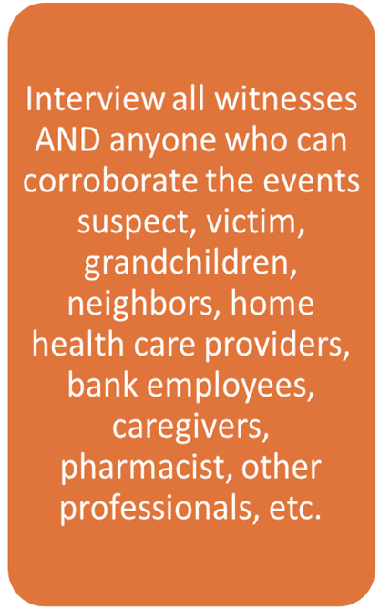
Ask About…
Unusual changes in behavior or emotions
Changes in sleep or eating habits
Avoidance of people or new relationships
Missed appointments
Withdraw from activities
Abrupt change in doctors or caregivers
Unusual changes in bank accounts and money management (unpaid bills, withdraws)
Unexplained or abrupt changes to wills, other financial documents, or transfer of assets or in attorneys
Disappearing funds or valuable assets
Notes:
Susan

Slide 15
Capacity Information TM
Abilities and medical needs of victim
Care provider responsibilities and schedule
How daily living needs are met for the victim (self versus caregiver)
Medications and assistive devices needed
Financial arrangements
Notes:
Susan

Slide 16
Factors to Consider When
Interviewing Older Individuals
Communication barriers
Individual variables such as age, race, ethnic background, education level, sexual orientation, socioeconomic status, etc.
Physical abilities
Cognitive abilities
Notes:
Susan
Susan
OVW, FLETC and NCALL (2012) Module 1: Elder Abuse Investigations SU

Slide 17
Communication Barriers
May not speak or read English
May not read or write
May be deaf
May need assistive devices to communicate
Notes:
Susan
OVW, FLETC and NCALL (2012) Module 1: Elder Abuse Investigations

Slide 18
Individual Variables
Many older adults are in good health and do not have physical or cognitive disabilities that significantly impact their lives or a law enforcement investigation. That said, be aware of possible physical or cognitive limitations that may have an impact on your investigation.
Officers’ perceptions
Older individuals’ perceptions of law enforcement
Communication or actions may be misunderstood or misinterpreted
Avoid making assumptions based on age, race, ethnic background or sexual identity
Respect cultural traditions as much as possible
Recognize gender of officer may make a difference when talking to some victims and suspects TM
Notes:
Susan
OVW, FLETC and NCALL (2012) Module 1: Elder Abuse Investigations

Slide 19
Physical Limitations
May need glasses, hearing aids, or other equipment to complete interview
May need assistance with getting to and from interviews (e.g. wheelchairs, walkers)
May need to eat, take medications and/or rest
TM
Notes:
Susan
OVW, FLETC and NCALL (2012) Module 1: Elder Abuse Investigations

Slide 20
Cognitive Limitations
  Temporary or Intermittent
  Permanent or Progressive
  Trauma
  Lack of food or water
  Medications
  Offender tactics
  Fatigue
  Infections
  Depression or other mental illnesses
  Traumatic brain condition
  Dementia (one form: Alzheimer’s Disease)
TM
Notes:
Investigative Strategies
Susan
OVW, FLETC and NCALL (2012) Module 1: Elder Abuse Investigations

Slide 21
Cognitive Limitations and the victim
Victims may be discounted if:
Statements are not consistent
They appear confused
They have difficulty recalling events
They may take longer to respond
They have a diagnosed medical condition like dementia or other cognitive limitation
TM
Notes:
Susan
OVW, FLETC and NCALL (2012) Module 1: Elder Abuse Investigations

Slide 22
Questions for Victims
Specifically ask about injuries, do not make assumptions!
Who are your caregivers? What are their duties?
Have the caregiver ever failed to meet their duties? If so, what was the result of their failure to provide proper care?
How do you get to your appointments?
How do you get to the store for groceries?
What medications do you take? Does someone give you the medication? Who helps you sort out what to take and when?
What did you eat and drink today?
Does anyone help you at home? How much? How often?
MH
Notes:
Mike

Slide 23
Questions for Neighbors
Who do you see visiting the victim, if anyone? How often?
Do you ever see the victim leave the home? When was the last time?
Who is the victim's caregiver, if anyone?
Who does the victim live with?
What do you know about the victim’s health? Finances?
Has the victim told you anything about her/his situation?
Have you noticed any changes over time in the victim’s health or behavior since the suspect began providing care? MH
Notes:
Mike

Slide 24
Questions for suspects
Do you get paid for caring for her/him? How much?
What are the terms of your agreement? Is it in writing?
What do you get in return for caring for him/her? Are you expecting to get anything more when the victim dies?
What does the victim do for her/himself? What does she/he need assistance with?
How often do you visit the victim?
How does the victim spend a day?
What does she/he do?
Whom does she/he see or have contact with? MH
Notes:
Mike

Slide 25
Think Outside of the Box
If the suspect is not present at the scene:
Will the victim text them? Try asking . . .
    Why did you hit me?
    Why did you leave when you knew the police were coming?
    Why did you try to break my phone?
    What should I say to make the police leave?
                MH
Notes:
Mike

Slide 26
LOCK suspects into a story
  Listen to all suspect explanations even those that are not full admissions or confessions.
  Even if the explanations are vague, keep asking questions
  Have them demonstrate, within reason of course!
Notes:
Mike

Slide 27
“Statements” by the suspect
“Confessions” OR Adoptive Admissions
    Preponderance of the Evidence Standard
    Accused heard the statements
    Understood the statements implicated him/her in a crime
    Fair opportunity to deny or object
    Circumstances would naturally call for a reply
    Before any 5th amendment implications attach
Notes:
Mike

Slide 28
Other sources for Interviews and Evidence Collection
Faith
Leaders
Advocates
Aging Network
Adult Protective Agencies
Health Professionals
Friends
Private Law Firm
Ombudsman
Family
Notes:
Susan

Slide 29
Adult Protective Services (APS)
APS investigates reports of abuse, neglect, & exploitation of adults 60 years of age or older and incapacitated adults aged 18 or older.
The goal of Adult Protective Services is to allow the adult to remain in the least restrictive setting and function as independently as possible.
APS Investigations begin within 24 hours of a report being made and should be completed within 45 days of a report.
Purpose of an APS Investigation:
  (1) Determine an adult’s need for protective services
  (2) Identify specific services needed
  (3) Arrange for the provision of protective services
  MH
Notes:
Susan

Slide 30
APS Investigations
Information can be gathered from:
  Mandated reporters
  Attorneys-in-fact
  Interviews with the victim, alleged perpetrator, and others
  Photographic evidence
Notify law enforcement in cases of sexual abuse, criminal abuse and neglect and can conduct joint investigations when appropriate
Refer to other regulatory licensing or legal authority for administrative action or criminal investigation and conduct joint investigations when appropriate MH
Notes:
Susan

Slide 31
How can Adult Protective Services assist law enforcement?
Emergencies, in cases involving an incapacitated adult
APS may enter the premises and remove the incapacitated adult.
APS may investigate and interview incapacitated adult without the consent of guardian or caregiver.
If caregiver or guardian is present, their consent is required for removal. NOTE: if investigator suspects caregiver caused the abuse or neglect, APS may seek court order for removal.
MH
Notes:
Susan: Highlight concurrent investigations and collaboration piece.

Slide 32
How can Adult Protective Services assist law enforcement?
Non-Emergencies
Investigate allegations of abuse, neglect and exploitation and make referrals to law enforcement
May obtain records without need of search warrants or court orders
Focus on services, not criminal justice
Department may petition for court order authorizing protective services for:
  Vulnerable adult who is being abused, neglected, or exploited
  Those lacking capacity to consent MH
Notes:
Susan

Slide 33
Contacting APS
During normal business hours,
call your local DSS office
After hours or to find your local DSS, call the state hotline at
1-888-832-3858
MH
Notes:
Susan

Slide 34

Thorough evidence collection
From call for service up until trial
Hearsay Exceptions – Rule 2:803
Notes:
Beth

Slide 35
Take your time - Make observations
Environment
People
Signs of neglect
Differences in living areas
Check the kitchen cabinets and the refrigerator
Check the medication cabinet
Evidence of drug/alcohol use
Observe windows, doors, locks, lighting
Injuries or lack thereof
Bruises, burns, cuts, welts, untreated bed sores
Appearance
Lack of medial aids (glasses, hearing aid, walker, teeth)
Demeanors
Notes:
Beth: Cleanliness, dirtiness, hoarding, malnutrition, dehydration, lack of basic hygiene, bed-bound without care, dementia/confusion, lack of amenities they should be able to afford

Slide 36
Record your observations
Can you get a video?
Copy or record video on-scene
Photographs
Follow up photos - injuries are ALWAYS different 3 to 5 days later
If you can see it, photograph it!
Do not delay getting a video
Surveillance footage at bank, ATMs
The absence of something can be just as important!
Notes:
Beth

Slide 37
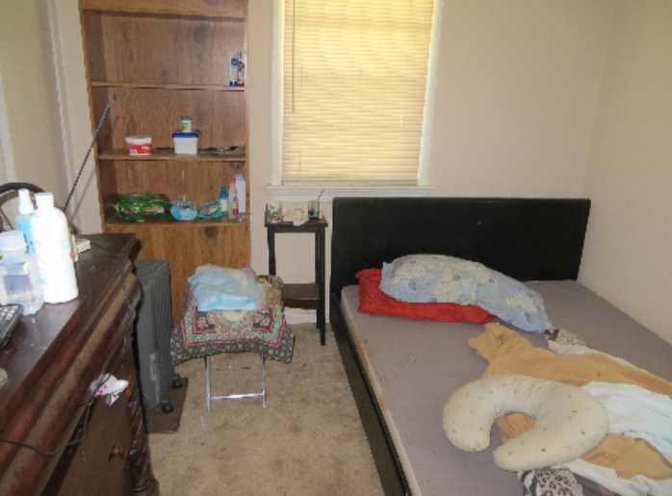
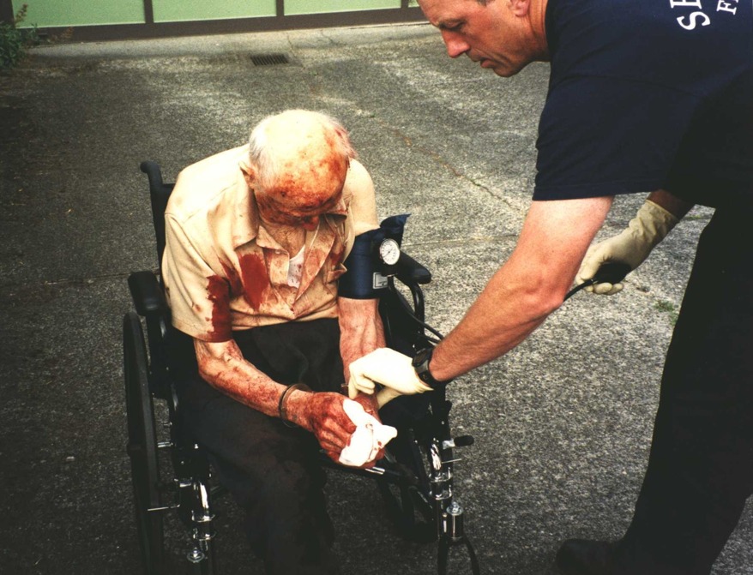
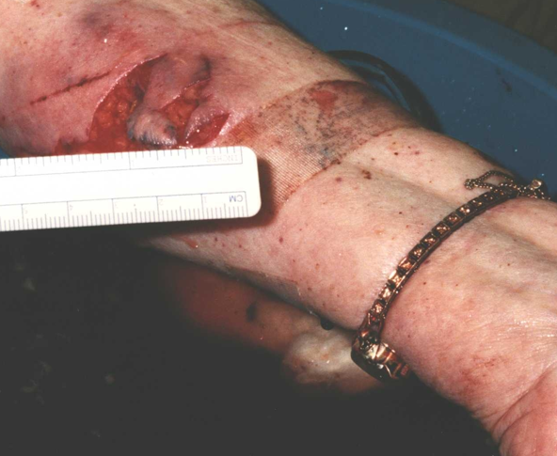
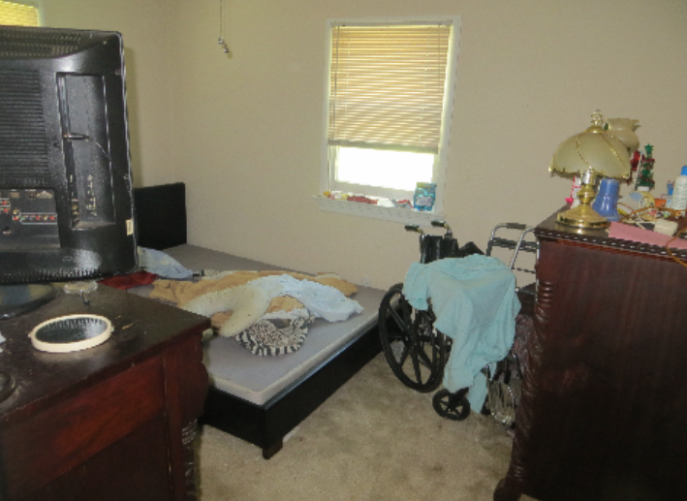
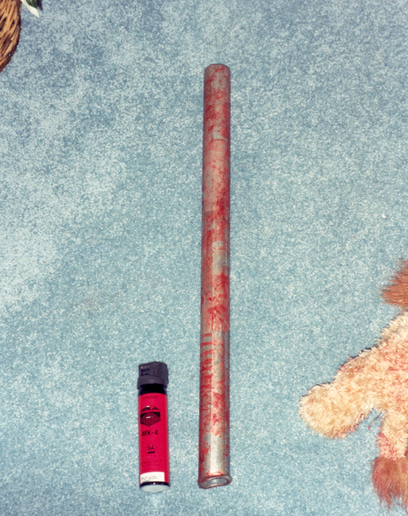
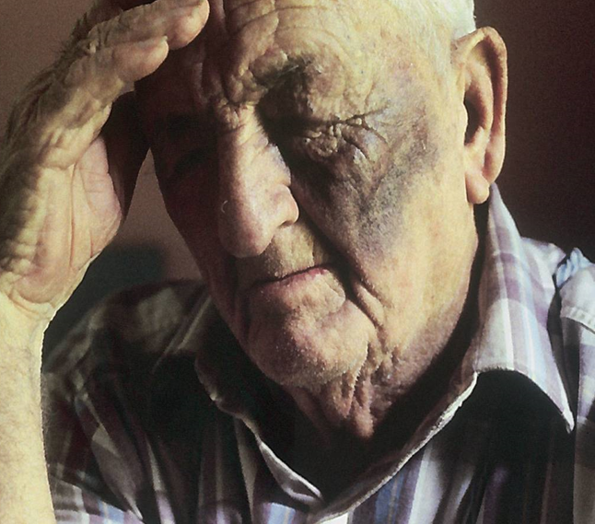
Photographs
Notes:
Beth

Slide 38
Do not rely on BWC!
Seize all corroborating physical evidence.
In court, an object is worth a thousand words.
  All weapons used – regardless
  Clothing (torn, stained, saturated)
  Clumps of Hair
  Bent towel rod
  Broken items
  Pools of blood; bloody items
  Pressure ulcers, overgrown nails
  Kitchen cabinets & refrigerator, living spaces, medicine cabinet
  ???????
Notes:
Beth

Slide 39
Photograph Documents first then seize
Power of Attorney documents
  Check for a gifting clause
Conservatorship / Guardianship documents
Other legal documents
Bank statements for victim and suspect
Tax records
Check books and registers
ATM/MAC transactions
Credit card statements
Overdue or unpaid bills
Receipts for purchases
Credit reports
Employment records for suspect
Pharmacy records
Capacity evaluations
Data from home or work computers
Journals
Copies of protective orders
              TM
Notes:
Beth

Slide 40
Court Orders/Subpoenas Duces Tecum
Multi-Jurisdictional Grand Juries (§§ 19.2-215.1 - 19.2-215.11)
Bank Records (§ 19.2-10.1)
Credit Card Records (§ 19.2-10.1)
Investment Accounts (§ 19.2-10.1)
Pharmacy Records through MJGJ (§ 54.1-2523(3))
  (Prescription Monitoring Program) MH
Notes:
Mike

Slide 41
Multi-Jurisdictional Grand Juries
Jurisdiction of MJGJ - §19.2-215.1
  To investigate any condition that involves or tends to promote criminal violations of: . . .
  d. §§ 18.2-111 [Embezzlement];
  e. § 18.2-59 et seq. [Extortion];
  f. § 18.2-152.1 et seq. [Computer Crimes] ; . . .
  p. §§ 18.2-30 et seq. [Homicide]; . . .
  r. § 18.2-186 et seq. [Identity Theft] and § 18.2-191 et seq. [Credit Card offenses]; . . . MH
Notes:
Mike

Slide 42
Multi-Jurisdictional Grand Juries
Powers of MJGJ - §19.2-215.5
  A multi-jurisdiction grand jury has statewide subpoena power and may subpoena persons to appear before it to testify or to produce evidence in the form of specified records, papers, documents or other tangible things.
Notes:
Mike

Slide 43
Bank and Credit Card Records
§19.2-10.1
Gives courts the power to order bank and credit card records, ex parte, without notice to bank or credit card customer and under temporary seal.
Do not need pending charge – just an investigation
Notes:
Mike

Slide 44
Medical Records and images
Hospital, EMS, FNE, PCP – names, agencies, contact information
Capacity evaluation and toxicology screen for victim
Mental health and substance abuse treatment records for suspect
Prescription records for suspect and victim
Notes:
Beth

Slide 45
Medical Records and images
EMS run sheets – § 32.1-127.1:03. Health records privacy.
  Request and Verification for Law Enforcement’s Access to Health Records Form
  D. Health care entities may, and, when required by other provisions of state law, shall, disclose health records:
  28. To law-enforcement officials by each licensed emergency medical services agency, (i) when the individual is the victim of a crime or (ii) when the individual has been arrested and has received emergency medical services or has refused emergency medical services and the health records consist of the prehospital patient care report required by § 32.1-116.1;
Medical release form
Search warrant / subpoena
  FNE – “forensic medical records and photography”
Notes:
Beth

Slide 46
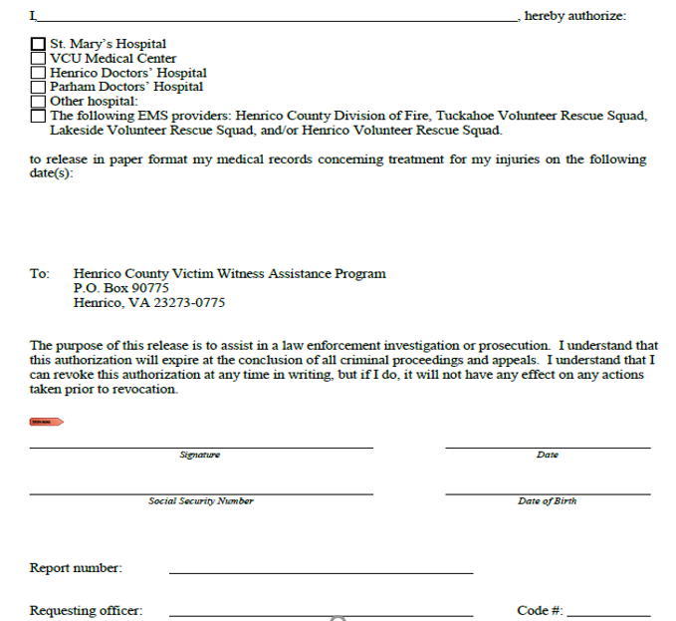
TM
Notes:
Beth

Slide 47
Hearsay Exception:
Statements for Purposes of Medical Treatment/Diagnosis
Statements about past/present symptoms or sensations made to medical personnel
  Permits medical personnel to testify as to statements made about past/current conditions for the basis for the treatment
  Rationale is that a patient making a statement to a treating physician recognizes that providing accurate is essential to receiving appropriate treatment
Notes:
Mike

Slide 48
Evidence from the jail
Audio Recordings,
Mail, Visitation Logs, and Cameras
Is there a protective order violation?
Is there a confession?
Who bonded the defendant out the picked them up?
Is the defendant pressuring the victim to not cooperate?
Notes:
Mike

Slide 49
Written statements and signed forms
From EVERYONE
Ensure you have contact information, not only phone numbers but addresses and email addresses
Go beyond who is on scene. Who are the doctors, care providers, attorneys, neighbors, extended family members, etc.?
What and where is the pharmacy, financial institution, salon, etc.?
Notes:
Mike: Get PCP and other medical provider contact information. Names of financial institutions

Slide 50
Written Statements from Victim(s)
Mainly for impeachment
Also, to refresh the recollection of uncooperative victims
Maybe Past Recollections Recorded
  Can use it for this purpose when:
    Recording is relevant
    Witness has no full or accurate recollection
    Witness has firsthand knowledge
    Witness made a record of those facts (his/her own handwriting)
    Record is the same as when it was made
Notes:
Mike

Slide 51

…AND the statement has changed!
At the trial or the preliminary hearing, they…
  Lied
  Minimized
  “Forgot”
  Now What???
  False Report? Perjury?
Notes:
Mike

Slide 52
911 Audio Recordings
911 audio recordings
  Can you hear an assault? An argument?
  Time limit to request
  No witness is needed with authentication per Virginia Code §8.01-390
Notes:
Mike

Slide 53
Hearsay Exception
Excited Utterances and
Spontaneous Statements
Descriptive
Quotations
Do not interrupt with questions
Notes:
Mike

Slide 54
Hearsay Exception:
Excited Utterance, Present-Sense Impression
Wilder v. Commonwealth 55 Va. App. 579 (2010)
Caison v. Commonwealth 52 Va. App. 423 (2008)
Dispatcher asked A LOT of questions
911 Calls
Be aware, this call was testimonial because there was NOT an ongoing emergency
Statements are nontestimonial when made in the course of police interrogation under circumstances objectively indicating that the primary purpose of the interrogation is to enable police assistance to meet an ongoing emergency. They are testimonial when the circumstances objectively indicate that there is no such ongoing emergency, and that the primary purpose of the interrogation is to establish or prove past events potentially relevant to later criminal prosecution.
Notes:
Mike

Slide 55
Statements of Existing Mental, Emotional, or Physical Condition
Statements describing presently existing state of mind, emotion, sensation, or physical conditions
  Less rigid requirements than excited utterances
  Statements may be made to anyone – no medical requirement
  May refer to pain, current symptoms or any other physical sensation – but not the cause
  It does not matter how long ago the injury happened if the pain is current
Notes:
Mike

Slide 56
Forfeiture by Wrongdoing
Prosecutors must show that the defendant engaged in or encouraged “wrongdoing” with the intent to make the witness/declarant unavailable.
History of domestic violence or domestic violence homicide in and of itself is insufficient.
Must prove that the defendant committed a wrongful act by which they intended to make, and successfully succeeded in making the declarant/victim unavailable.
“thwart the judicial process”
Several legal hoops to jump through,
but prosecutors need officers to give them the tools to do it!
Good case for the Commonwealth:
Cody v. Commonwealth, 68 Va. App. 638 (2018)
Notes:
Mike

Slide 57
Cody v. Commonwealth, 68 Va. App. 638 (2018)
Forfeiture by wrongdoing applies when a defendant causes a witness' unavailability at trial, by a wrongful act, undertaken with the intention of preventing the witness from testifying.
With the protective order in effect and while he was incarcerated, Cody made five phone calls to Weingarten.
Issue decided in case: Whether the doctrine applies to a situation where a defendant, by his misconduct, contacts a witness contrary to law and successfully procures a witness' unavailability through the witness' exercise of the Fifth Amendment right to avoid self-incrimination and steadfast refusal to testify notwithstanding an offer of immunity from prosecution.
The facts included that during five separate violations of a protective order, Cody slowly wore down the victim with his persistence and emotionally manipulative behavior and convinced her not to cooperate further in his prosecution.
Notes:
Mike

Slide 58

Detailed Documentation
Notes:
Mike

Slide 59
Norman v. Commonwealth
(15 Va. App. 1058148 2015 – unpublished)
“The trial court was not required to accept Maya’s version of the events. Trial courts are confronted on a daily basis with victims of domestic abuse who are reluctant to bring to justice those who frighten and abuse then, whether from motives of affection, financial dependence, ongoing fear or some other reason.”
Notes:
Mike

Slide 60
Norman v. Commonwealth
(15 Va. App. 1058148 2015 – unpublished)
“. . . Trial judges need not blind themselves to these realities when they make factual determinations. Trial courts may accept or reject the victim’s testimony as plausible, depending on the facts of each case. The trial court’s factual conclusions here were neither plainly wrong nor were they without evidence to support them.”
Notes:
Mike

Slide 61
Detailed Documentation
How long does it take to get from arrest to trial?
Months?
Years?
And what if there isn’t an immediate arrest?
How many reports in between?
Properly save and store all evidence
Notes:
Beth

Slide 62
Detailed reports
  Excited utterance or spontaneous statements
  Condition of the crime scene
    What did you see, hear, and smell?
  Relationship of the parties
  Contact information for all parties and witnesses
  Facts and circumstances surrounding the initial call for service
  Detailed account from both parties as to what occurred
  Statements of any witnesses
  The emotional state of all parties
  Injuries, who caused them, and the weapons or objects that were used
  Current or previous threats made against the victim
  Damage to property or injury to pets
  Allegations of strangulation
  Allegations of forced sexual contact
  Allegations of stalking behavior TM
Notes:
Beth

Slide 63
Detailed reports
  Whether the suspect has access to firearms and/or if firearms are present at the scene
  Presence or use of drugs or alcohol
  Victim’s statements as to the frequency and severity of prior incidents of abuse by the same person
  Pending court cases or current probation status
  Victim’s statements as to the number of prior calls for law enforcement assistance
  Whether or not a protective order exists or was obtained
  Legal and community resources provided to the victim
  Name of professionals contacted and summary of your conversation with them
  Whether or not transportation to a hospital, safe shelter, or the Magistrate’s Office was provided to the victim
  Disposition of your investigation to include whether an arrest was made or if warrants were obtained
Notes:
Beth

Slide 64
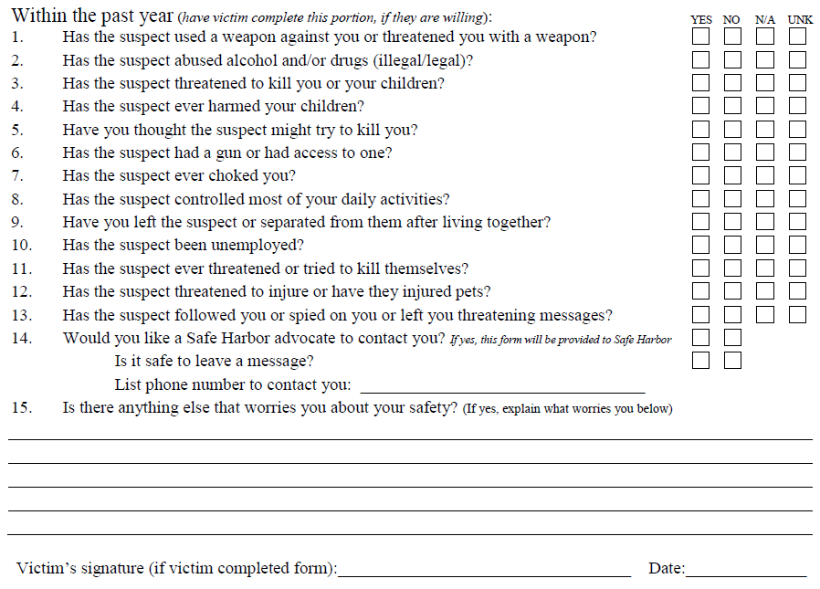
Lethality assessments
TM
Notes:
Beth

Slide 65
What about facility investigations?
Notes:
Susan

Slide 66
When Neglect Occurs in a Care Facility
Conduct like any other investigation
Collect additional evidence such as medical records, patient charts and staffing documents
Contact:
  State Regulatory & Licensing Agencies
  Medicaid Fraud Control Unit (MFCU)
  Ombudsman (Contact through Area Agency on Aging)
Notes:
Susan

Slide 67
Long Term Care Ombudsman
The Ombudsman serves as an advocate to protect and improve the quality of care and the quality of life of long-term care recipients, whether the care is provided in a nursing home or assisted living facility, or through community-based services to assist persons still living at home.
Ombudsmen:
Investigate and resolve complaints about long-term care services
Assist residents in exercising their rights
Mediate concerns between residents or their families and the facility staff
Provide residents and their families with information about residents’ rights, government benefits, and other agencies which can be of assistance.
MH
Notes:
Susan

Slide 68
State Ombudsman
  Virginia Long-Term Care Ombudsman Program
  Department for Aging and Rehabilitative Services
  8004 Franklin Farms Drive Henrico, VA 23229-5019
  http://www.elderrightsva.org/
  Toll Free Number:
  (800) 552-3402
Joani Latimer,
State Long-Term Care Ombudsman
Phone: (804) 726-6624
Gail Thompson,
Assistant State Long-Term Care Ombudsman
Phone: (804) 726-6617
Susan Johnson,
CCC Advocate Manager
Phone: (804) 662-7162
Notes:
Susan

Slide 69
Presenter Contact Information
  Tana Mooney, 804-318-8110, mooneyt@chesterfield.gov
Mike Huberman, 804-501-5819, hub09@henrico.us
Notes:
Susan

